Slide 1

DEPARTMENT OF COMPUTER SCIENCE AND ENGINEERING
PROJECT REVIEW
Multi Source AI for Hyperlocal Rainfall Nowcasting
Team Members:
1. Ariyan M - 23UCS015
2. Bharath B - 23UCS025
3. Hemnnath G - 23UCS066
Guide Name: Dr. N. Danapaquiame
Professor and Head

Slide 2
Artificial Intelligence and Machine Learning is the domain that enables computers to learn patterns from data and make predictions or decisions. In this project, deep learning techniques are used to analyze meteorological data and predict rainfall intensity and occurrence over short time periods.
Weather Data Analytics and Meteorology is the domain concerned with collecting, processing, and analyzing atmospheric information such as temperature, humidity, pressure, rainfall, and wind. It is used to understand local weather conditions and identify atmospheric patterns associated with rainfall.
Internet of Things (IoT) and Sensor Data Fusion provide the infrastructure for collecting real-time environmental observations from distributed weather stations. Personal Weather Stations (PWS), Automatic Weather Stations (AWS), and other weather data sources are used to provide hyperlocal observations that can be combined for improved rainfall prediction.
Precipitation Nowcasting and Numerical Weather Prediction (NWP) focus on predicting rainfall over short time horizons and combining numerical weather model outputs with local observations. They are used to provide hyperlocal rainfall predictions for the next few hours and support applications such as flood monitoring, agriculture, transportation, and disaster management.
Web and Database Technologies provide the supporting infrastructure for the weather intelligence platform. They are used to collect, store, process, expose, and visualize real-time weather data and AI-generated rainfall predictions through an interactive web dashboard.
Domain Introduction

Slide 3
Our Idea
Modern weather monitoring involves multiple information sources such as weather stations, personal weather stations, satellite observations, and numerical weather prediction models. Traditional weather forecasting often struggles to capture short-duration and highly localized rainfall events, especially in regions such as Puducherry and Tamil Nadu. This project is based on the idea of automatically generating accurate hyperlocal rainfall nowcasts by integrating multi-source weather data with AI-driven deep learning models. The system processes real-time observations, performs feature engineering and data fusion, and predicts rainfall for the next few hours through an interactive web-based platform.
Existing Solutions
Abstract
Current weather forecasting systems mainly rely on numerical weather prediction models and individual weather data sources. These systems often operate at coarse spatial and temporal resolutions, making it difficult to accurately capture short-duration and highly localized rainfall events. Existing approaches also do not effectively combine real-time observations from weather stations, personal weather stations, and multiple forecasting models, resulting in limited accuracy for hyperlocal rainfall prediction and short-term nowcasting.
Proposed Solution
The proposed AI-powered hyperlocal rainfall nowcasting system integrates real-time weather observations from multiple sources, including weather stations, personal weather stations, and Open-Meteo, with deep learning and numerical weather prediction models. By performing data preprocessing, feature engineering, and multi-source data fusion, the system generates short-term rainfall predictions for the next few hours. The results are presented through an interactive web dashboard, enabling accurate, localized, and real-time rainfall monitoring and nowcasting.

Slide 4
• Coarse Spatial and Temporal Resolution
Most traditional weather forecasting systems operate at relatively coarse spatial and temporal resolutions, making it difficult to capture short-duration and highly localized rainfall events.
• Limited Hyperlocal Prediction Accuracy
Conventional numerical weather prediction models may not accurately represent localized convective rainfall, especially in coastal regions where weather conditions can change rapidly.
• Fragmented Weather Data Sources
Weather observations are often collected from separate sources such as weather stations, personal weather stations, and forecasting models, making it difficult to combine them into a unified and consistent dataset.
• Lack of Real-Time Multi-Source Data Fusion
Existing systems generally do not effectively integrate real-time observations with AI-based nowcasting and multiple NWP model outputs, limiting their ability to provide accurate short-term rainfall predictions.
• Difficulty in Predicting Rapid Rainfall Changes
Sudden changes in temperature, humidity, pressure, and wind can lead to rapid rainfall development, which traditional forecasting approaches may fail to capture effectively.
Drawbacks of Existing Work

Slide 5
• Multi-Source Data Acquisition
The system collects real-time weather observations from multiple sources, including IMD AWS, personal weather stations, and Open-Meteo, providing a comprehensive view of local atmospheric conditions.
• Integrated AI-Based Processing
Deep learning models such as LSTMAtU-Net and the proposed TransAtU-Net process weather data and learn complex spatial and temporal patterns to generate short-term rainfall predictions.
• Data Fusion and Feature Engineering
Data from different sources is cleaned, synchronized, and combined with important atmospheric features such as temperature, humidity, pressure, wind, and rainfall trends to improve prediction accuracy.
• Hyperlocal Rainfall Nowcasting
The system generates rainfall predictions for short time horizons and combines AI predictions with multi-model NWP guidance to provide localized and reliable rainfall information through an interactive web dashboard.
Proposed Solution

Slide 6
Sub Domains and Issues
Weather Data Acquisition
AI & Deep Learning
Weather Data Fusion & Nowcasting
Synchronizing observations from different sources.
Combining station data with NWP model predictions.
Maintaining accuracy across different locations and weather conditions.
Generating reliable short-term forecasts in real time.
Integrating data from multiple weather sources.
Handling different data formats and sampling intervals.
Missing or inconsistent observations can affect reliability.
Real-time data collection requires continuous monitoring.
Capturing complex spatial and temporal rainfall patterns.
Predicting highly localized and rapidly changing rainfall.
Handling class imbalance between rainfall and non-rainfall events.
Higher-resolution models require significant computational resources.

Slide 7
Sub Domains and Issues
Numerical Weather Prediction (NWP)
Feature Engineering & Data Preprocessing
Real-Time Monitoring & Visualization
Coarse spatial resolution limits hyperlocal rainfall prediction.
Different models may produce varying rainfall forecasts.
Model updates may not capture sudden weather changes.
Combining multiple NWP outputs requires careful weighting.
Weather data may contain missing or inconsistent observations.
Different sources use different measurement intervals and formats.
Atmospheric features must be engineered to capture rainfall conditions.
Poor-quality input data can reduce model prediction accuracy
Continuous weather updates require efficient data processing.
Large amounts of real-time data can increase system load.
Forecast results must be presented clearly for easy interpretation.
Maintaining responsive dashboards while processing live data can be challenging

Slide 8
Literature Survey
Sl. No. | Sub Domains | Papers Count | Advantages | Disadvantages
1 | Precipitation Nowcasting | 3 | Deep learning models effectively capture spatial and temporal rainfall patterns for short-term prediction. | Prediction quality decreases for longer lead times and rapidly changing rainfall events.
2 | Spatio-Temporal Deep Learning | 4 | ConvLSTM, TrajGRU, and related models can learn complex movement and evolution of rainfall patterns. | Recurrent models may suffer from memory decay, computational complexity, and prediction blurring.
3 | Attention-Based Rainfall Prediction | 2 | Attention mechanisms help the model focus on important spatial and meteorological features. | Attention-based architectures can require higher computational resources and careful tuning.
4 | Weather Data Fusion | 3 | Combining weather stations, PWS observations, and other sources provides richer and more localized weather information. | Different sources may have missing data, different sampling intervals, and measurement inconsistencies.
5 | Numerical Weather Prediction (NWP) | 4 | Models such as ECMWF, GFS, and ICON provide reliable large-scale atmospheric forecasts. | Coarse spatial and temporal resolution limits their ability to capture hyperlocal and rapidly developing rainfall.
6 | Machine Learning Weather Forecasting | 2 | RF and XGBoost provide fast inference and useful baselines using meteorological features. | Tabular models have limited ability to learn complex spatial rainfall structures and continuous rain-cell movement.

Slide 9
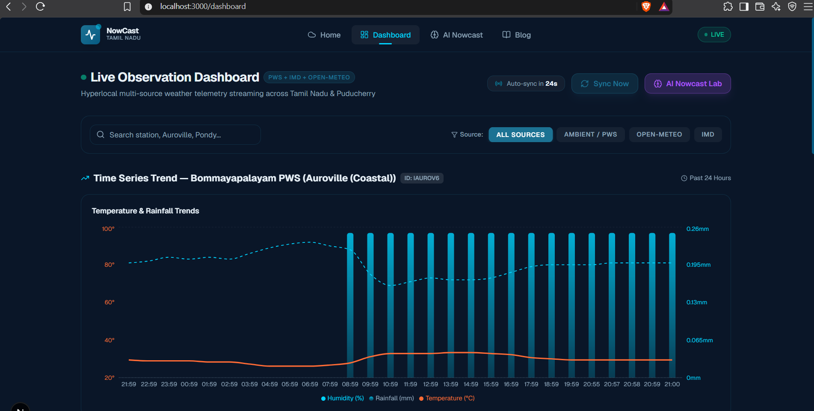
Implementation

Slide 10
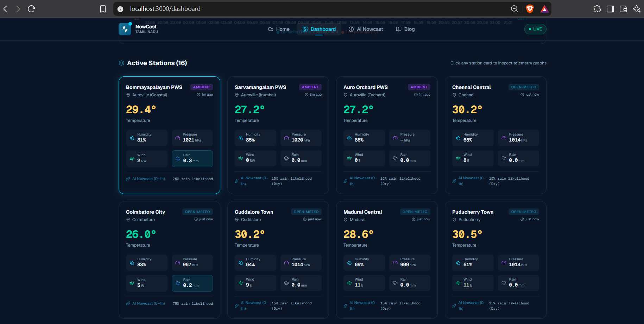
Implementation

Slide 11
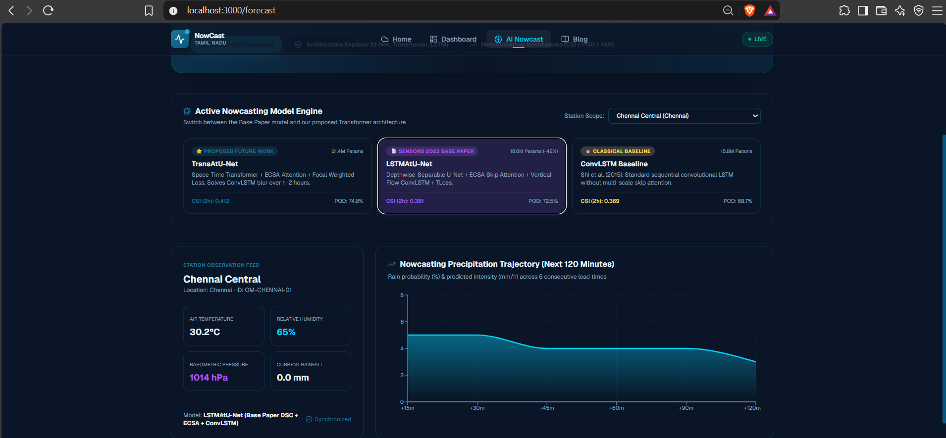
Implementation

Slide 12
Data Acquisition & Ingestion Module
Feature Engineering Module
Collects real-time weather data from IMD AWS, PWS, and Open-Meteo.
Performs periodic data ingestion and 24–48 hour historical backfilling.
Cleans, validates, and stores weather observations.
Derives pressure trends, humidity gradients, dew point spread, and spatial features.
Aligns observations from different stations and time intervals.
Prepares predictive features for the AI nowcasting models.
Modules
AI Nowcasting Module
NWP & Forecast Fusion Module
Processes spatio-temporal weather data using LSTMAtU-Net.
Uses the proposed TransAtU-Net with spatio-temporal attention.
Generates short-term rainfall predictions for multiple forecast horizons.
Integrates forecasts from ECMWF, GFS, ICON, and AI models.
Combines model outputs using weighted multi-model rainfall blending.
Generates localized rainfall guidance across Tamil Nadu and Puducherry.

Slide 13
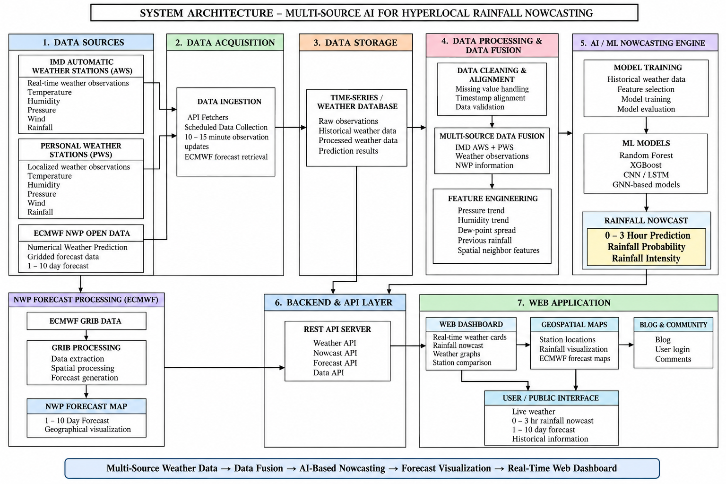
Architectural
diagram

Slide 14
Future Enhancements
The system could integrate live weather radar data to improve the detection and tracking of rapidly developing rainfall cells.
Future versions could further improve the proposed TransAtU-Net using larger spatio-temporal Transformer architectures and advanced attention mechanisms.
Real-Time Radar Integration
Advanced Transformer Models
Automated Alert and Warning System
Expanded Sensor Network
Adaptive Multi-Model Forecasting
The platform could send location-based rainfall alerts through mobile notifications, SMS, or WhatsApp when heavy rainfall is predicted.
More IMD AWS and community PWS stations could be integrated to increase observation density and improve hyperlocal prediction accuracy.
The system could dynamically adjust ECMWF, GFS, ICON, and AI model weights based on their recent prediction performance.

Slide 15
The “Multi-Source AI for Hyperlocal Rainfall Nowcasting” is a significant step toward improving short-term and localized rainfall prediction through AI and multi-source weather data fusion. By integrating real-time observations from weather stations and personal weather stations with deep learning models and numerical weather prediction outputs, the system provides a unified platform for monitoring and predicting rainfall at a hyperlocal level.
Ultimately, this technology can support early awareness of heavy rainfall, urban flooding, transportation disruptions, and other weather-related risks. The proposed platform provides a strong foundation for accurate, real-time, and scalable rainfall nowcasting across Puducherry and Tamil Nadu.
Conclusion

Slide 16
Thank You

Slide 17
Sub Domains | Papers Count | Key Takeaway
Precipitation Nowcasting | 3 | Deep learning models can effectively capture spatial and temporal rainfall patterns for short-term prediction.
Spatio-Temporal Deep Learning | 4 | ConvLSTM and TrajGRU improve the modelling of rainfall movement and temporal changes.
Attention-Based Rainfall Prediction | 2 | Attention mechanisms help the model focus on important spatial and meteorological features.
Weather Data Acquisition & Fusion | 3 | Combining multiple weather sources provides richer and more localized atmospheric information.
Numerical Weather Prediction (NWP) | 4 | ECMWF, GFS, and other NWP models provide useful large-scale guidance but have limitations for hyperlocal rainfall.
Machine Learning Weather Forecasting | 2 | RF and XGBoost provide fast and useful baseline predictions from station-level weather features.
Literature
Survey

